Slide 1
Coalgebraic components in a many-sorted microcosm
Ichiro Hasuo
Kyoto, JP
Chris Heunen
Nijmegen, NL (→ Oxford, UK)
Bart Jacobs
Nijmegen, NL
Ana Sokolova
Salzburg, AT
TexPoint fonts used in EMF.
Read the TexPoint manual before you delete this box.: AAA

Slide 2
Outline
Hughes’ arrow, Freyd category, … from functional programming
components (state-based machines) | as | coalgebras
their behaviors | by | final coalgebra
calculus on them | as | algebraic structure
Universal coalgebra in CS
SOS by bialgebras
compositionality
results
The Microcosm Principle
[Baez-Dolan][Hasuo-Jacobs-Sokolova, FoSSaCS’08]
what’s new: many-sorted, pseudo algebra

Slide 3
Behavioral view on component calculi
Part 1

Slide 4
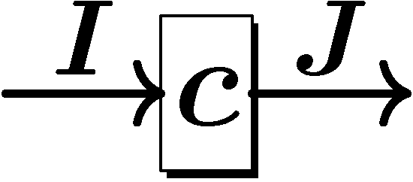
Component calculus
I
component
state-based machine
with I/O interfaces
component calculus
algebraic structure on components
compose components to build a bigger system
c
J
sequential composition

Slide 5
Component calculus: background
Modular design
Against fast-growing complexity of systems
Brings order to otherwise messed-up design process
Middle-ware layer
You won’t code everything from scratch, but
buy software components from other vendors,
which you compose

Slide 6
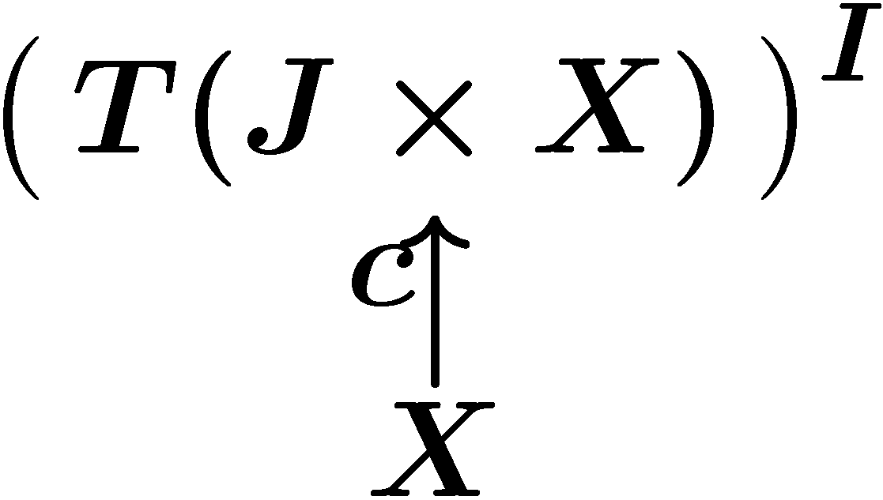
Components as coalgebras [Barbosa, PhD thesis]
I
c
as
in Sets
J
T : a monad for effect (cf. func. programming)
P (powerset) | non-determinism
1+ _ | exception
(S £ _)^{S} | global state
DX = { d: X→ [0,1] | ∑_{x} d(x) = 1} | probability

Slide 7
Component calculus = algebra on Coalg_{F}
binary operation
no effect, for simplicity
signature:
➔ Mealy machines

Slide 8
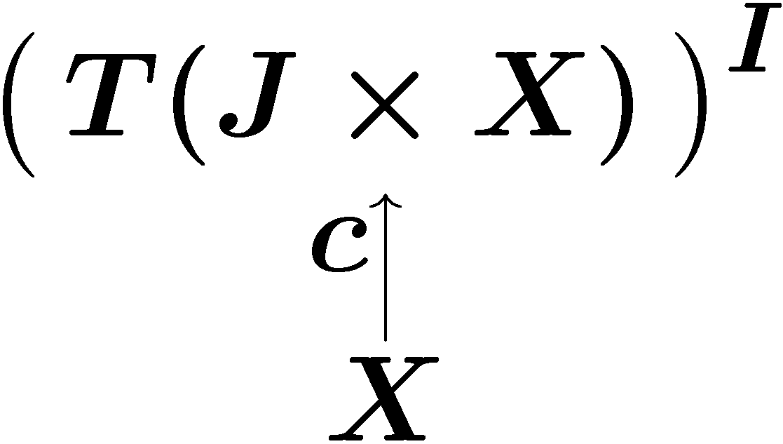
Behavioral view
Summary
component as coalgebra
component calculus as
algebra on Coalg_{F}
Behavior of components?
compositionality of calculus
coalgebraic view
I
c
as
J

Slide 9
Behavior by coinduction
That is,
depends only on
n
…
(output)
internal state x
n
I
…
c
(input)
J

Slide 10
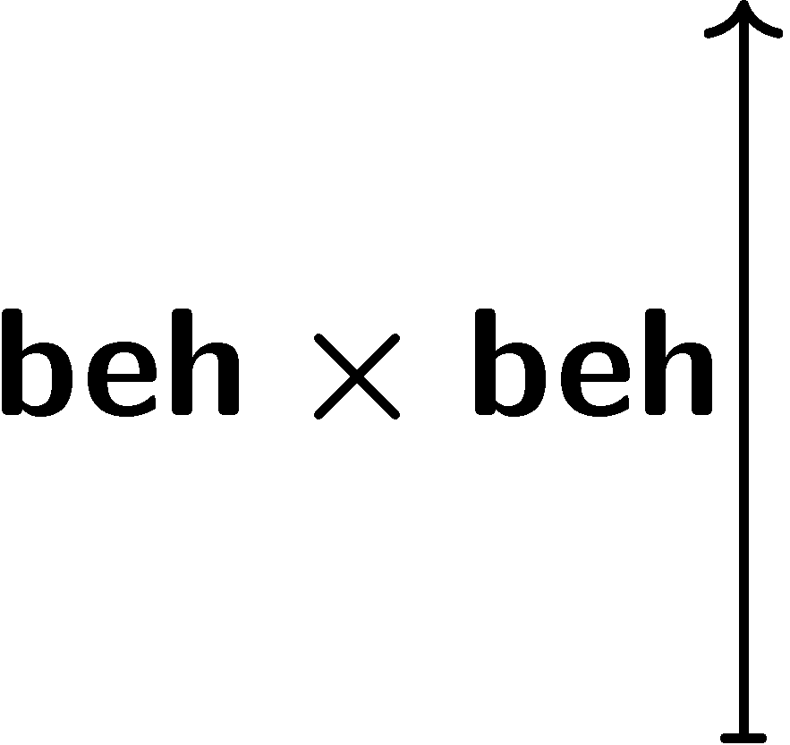
Another “sequential composition”
=?
x
y
x
y
Two “sequential composition” operators
Are they “compatible”? ➔ compositionality

Slide 11
One arises from the other
by coinduction definition principle

Slide 12
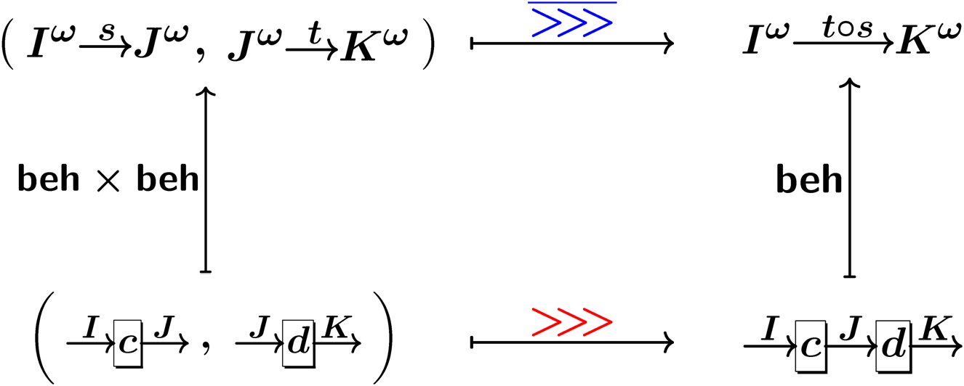
Compositionality
=
i.e.
by coinduction proof principle

Slide 13
Nested algebraic structure: the microcosm principle
with
inner interpretation
X 2 C
outer interpretation
algebraic theory
operations
binary
equations
e.g. assoc. of

Slide 14
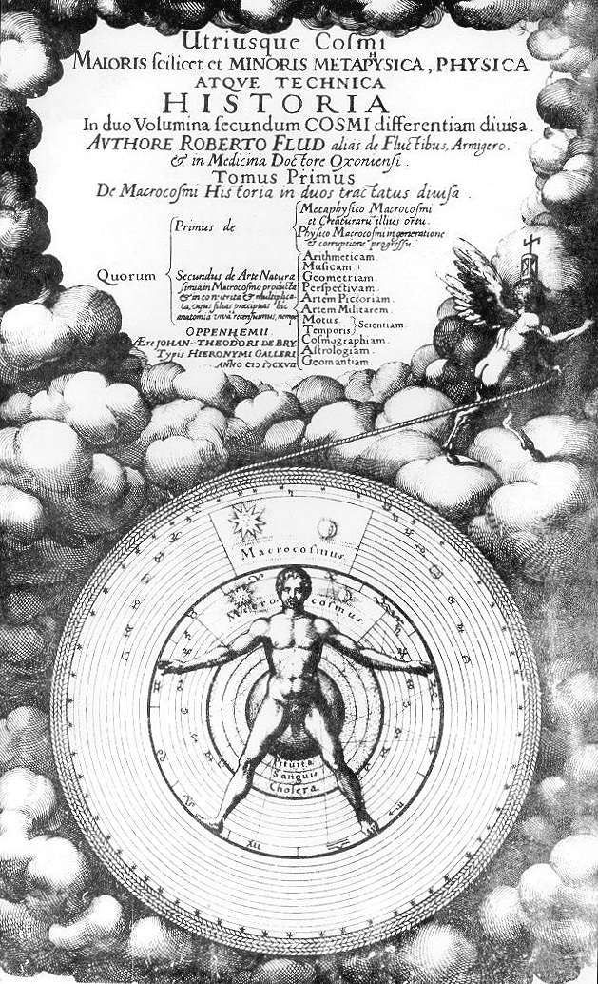
Microcosm in macrocosm
We name this principle the microcosm principle, after the theory, common in pre-modern correlative cosmologies, that every feature of the microcosm (e.g. the human soul) corresponds to some feature of the macrocosm.
John Baez & James Dolan
Higher-Dimensional Algebra III:
n-Categories and the Algebra of Opetopes
Adv. Math. 1998

Slide 15
The microcosm principle: a retrospective
Baez-Dolan
Adv. Math. 1998
formalization for alg. str. as opetopes
Hasuo-Jacobs-Sokolova
FoSSaCS 2008
formalization for alg. str. as Lawvere theories
example: parallel composition of coalgebras
Current work
what’s new?
many-sorted → components (varying I/O types)
pseudo algebraic structure
Hasuo 2009, preprint
for full GSOS → “2-dimensional GSOS”
for use in homotopy theory, n-categories

Slide 16
Main result: compositionality
We study three component calculi: PLTh, ArrTh, MArrTh. For each of them:
We introduce algebraic structure on Coalg_{F}
such as
from which algebraic structure on Z canonically arises
such as
by coinduction (def. principle)
relating the two, we have the compositionality property
by coinduction (proof principle)

Slide 17
The microcosm
principle
Part 2

Slide 18
The microcosm principle
inner model
outer
model
inner interpretation
X 2 C
outer interpretation
algebraic theory
operations
binary
equations
e.g. assoc. of
Examples
components and their behaviors
monoid in a monoidal category

Slide 19
Microcosm principle in [MacLane, CWM]
monoid in a monoidal category
You may have seen it
“a monoid is in a monoidal category”

Slide 20
Lawvere theory L
a category representing an algebraic theory

Slide 21
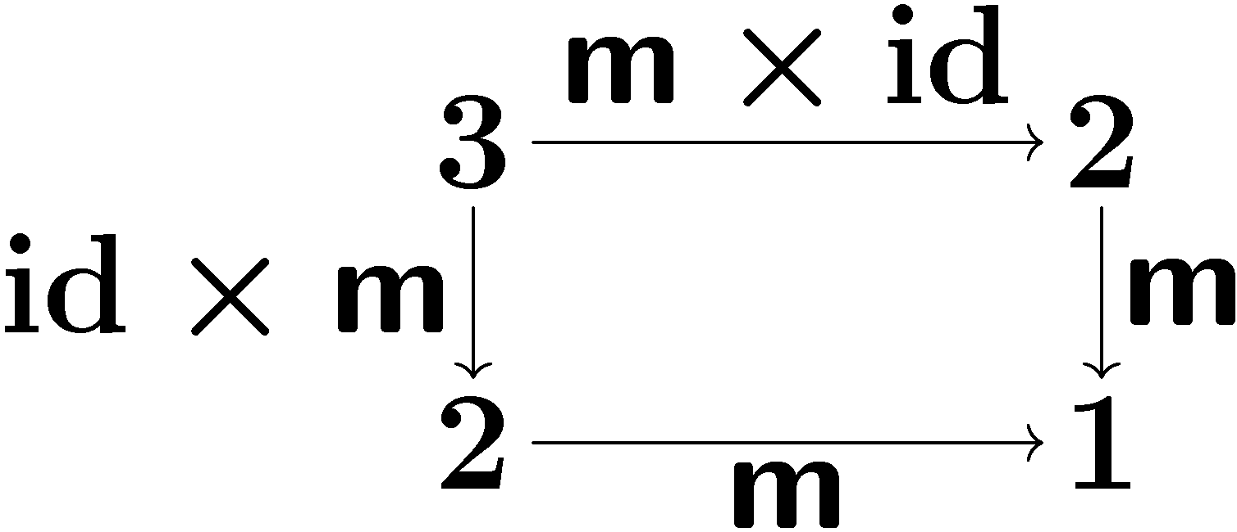
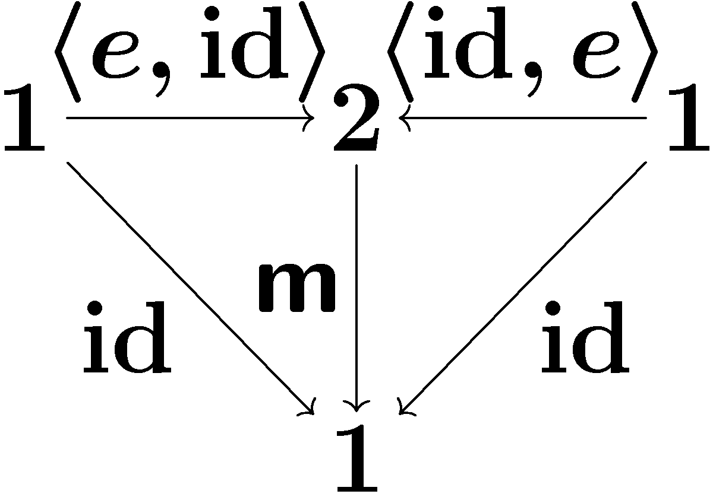
Lawvere theory
algebraic theory | as category L
operations | as arrows
equations | as commuting diagrams
m (binary)
e (nullary)
assoc. of m
unit law

Slide 22
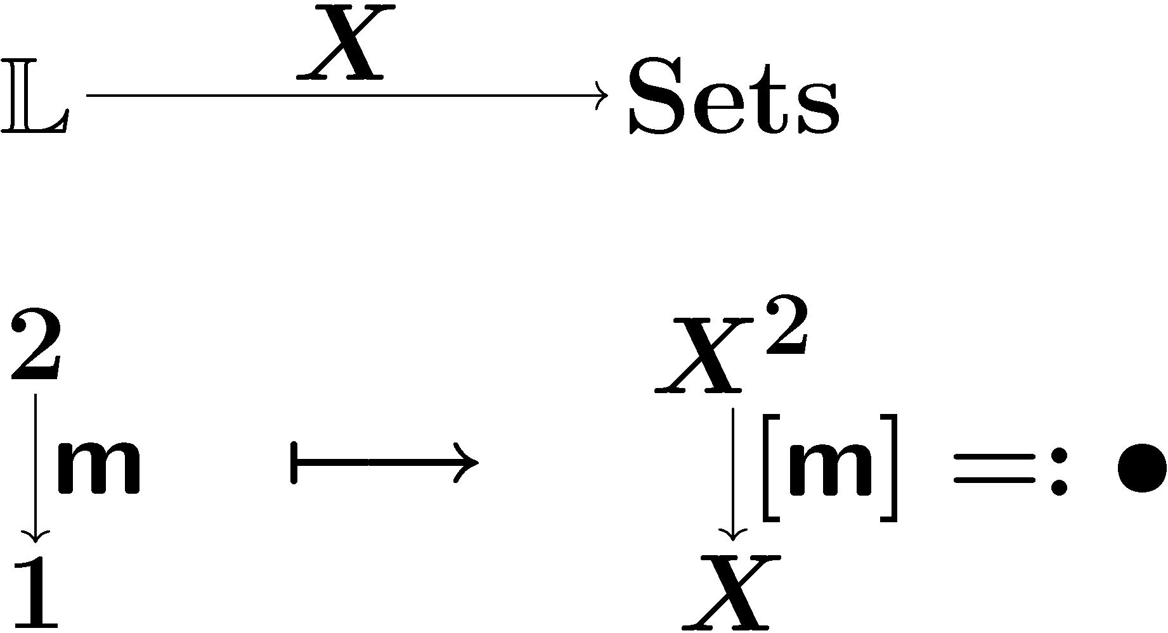
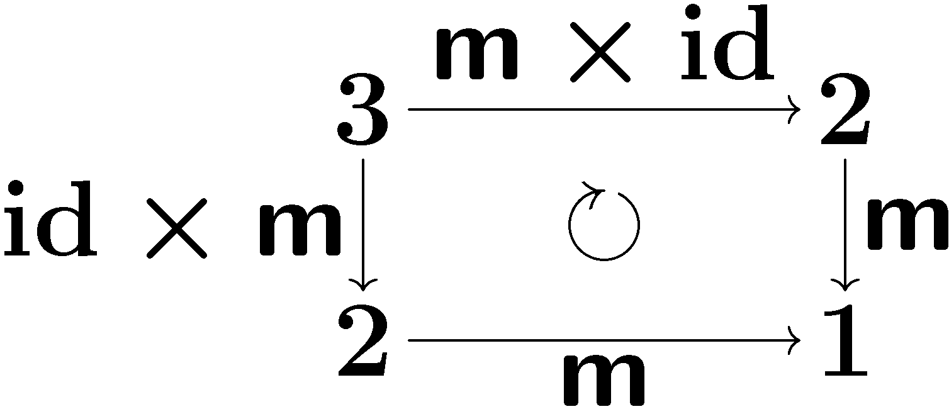
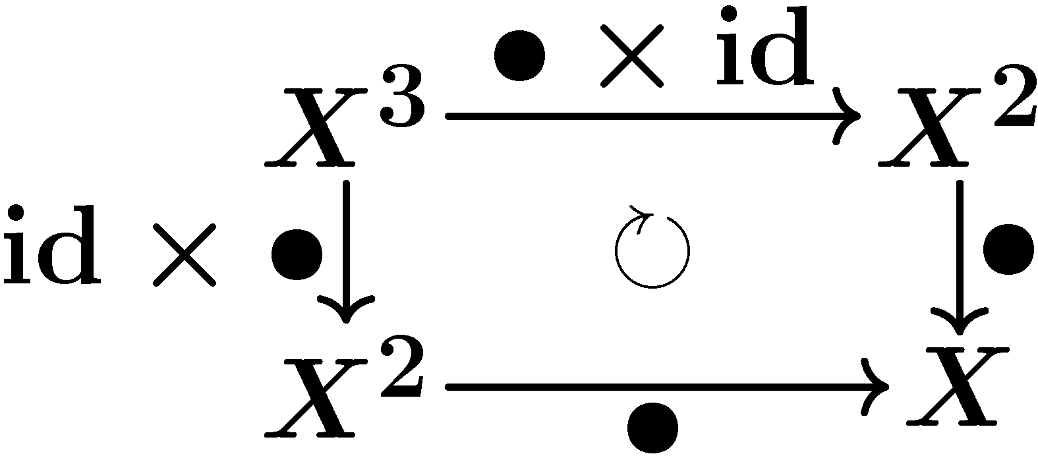
Models for Lawvere theory L
Standard: set-theoretic model
a set with L-structure ➔ L-set
(product-preserving)
binary opr. on X
associativity
what about nested models?
X 2 C

Slide 23
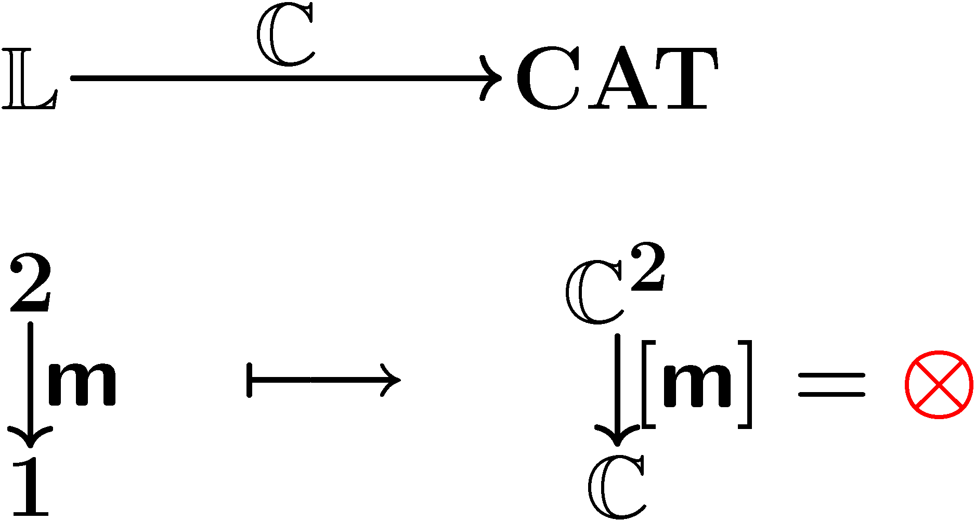
Outer model: L-category
outer model
a category with L-structure: L-category
(product-preserving)
NB. This works only for strict algebraic structure

Slide 24
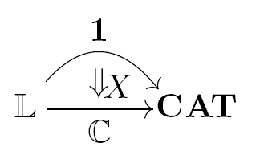
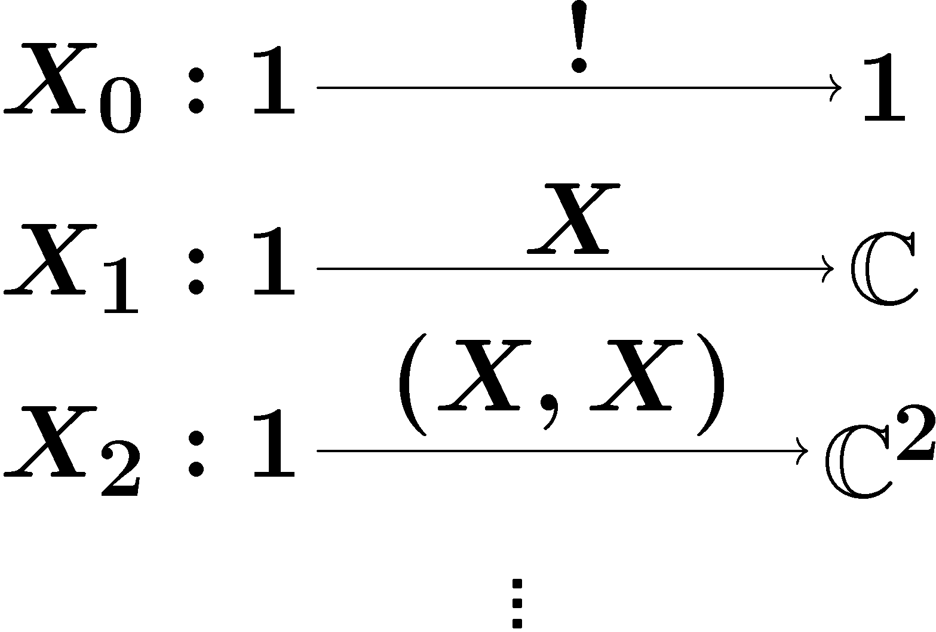
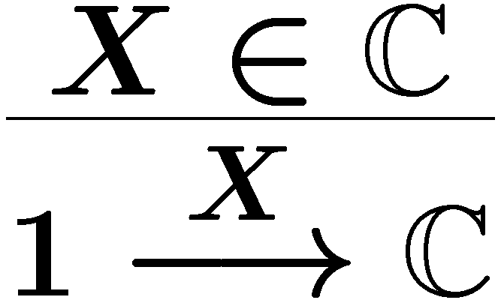
Inner model: L-object [cf. Benabou]
Definition
inner alg. str.
by
mediating 2-cells
Given an L-category C,
an L-object X in it
is a lax natural transformation
compatible with products.
components
lax naturality
X: carrier obj.
Definition
Components

Slide 25
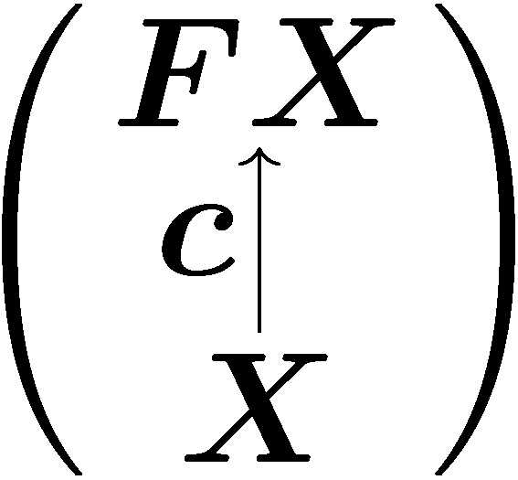
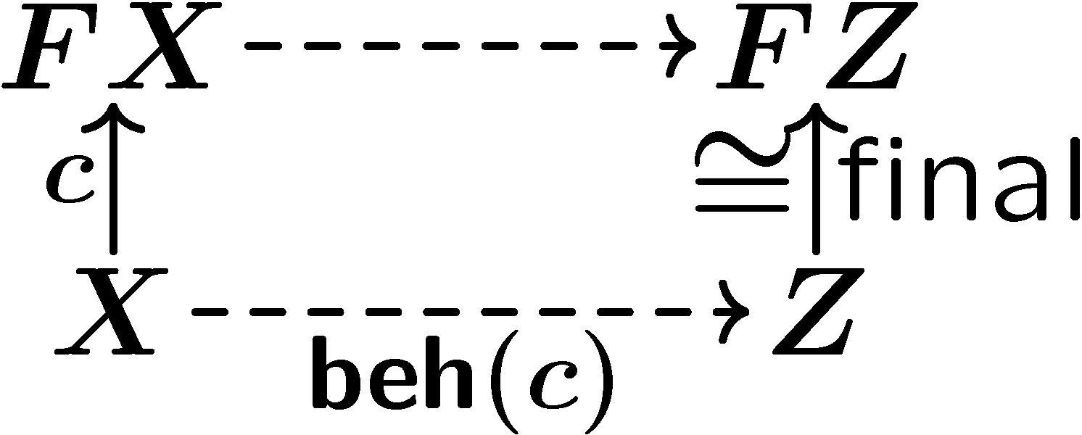
Compositionality theorem
C is an L-category
F : C → C is a lax L-functor
there is a final coalgebra Z → FZ
Assume
1. Coalg_{F} is an L-category
2. Z → FZ is an L-object
3. the behavior functor
is a (strict) L-functor
by finality
yields
by coinduction

Slide 26
What’s new (1): many-sorted
sorts: (I,J), (J,K), etc.
The specification:
arity: formal product of sorts
one-sorted case:

Slide 27
What’s new (2): pseudo alg. str.
Equations hold
not up-to equalities,
but up-to isomorphisms
assoc. of
I
J
K
, ,
c
d
e
J
K
L
cf. monoidal category
coherence ☹
I
I
c
c
J
J
d
d
K
K
state space:
e
e
L
L

Slide 28
Functorial semantics
outer model
a category with L-structure: L-category
(product-preserving)
NB. This works only for strict algebraic structure

Slide 29
Formalizing pseudo alg. str.
Lawvere 2-theory [Power, Lack]
explicit isomorphisms, explicit coherence
theory of monoids:
theory of monoidal categories:
“2-functorial semantics”
model = category with L-structure
it is a product-preserving 2-functor L → CAT
not quite a suitable solution for us…

Slide 30
Formalizing pseudo alg. str.
Hasuo, preprint 2009
available on the web
Pseudo functorial semantics
Segal took the same approach in TQFT, topological quantum field theory
but for monoidal (not cartesian/Lawvere) theory L
Definition
Definition
An L-category is a finite-product preserving pseudo functor L → CAT
An L-category is a finite-product preserving pseudo functor L → CAT

Slide 31
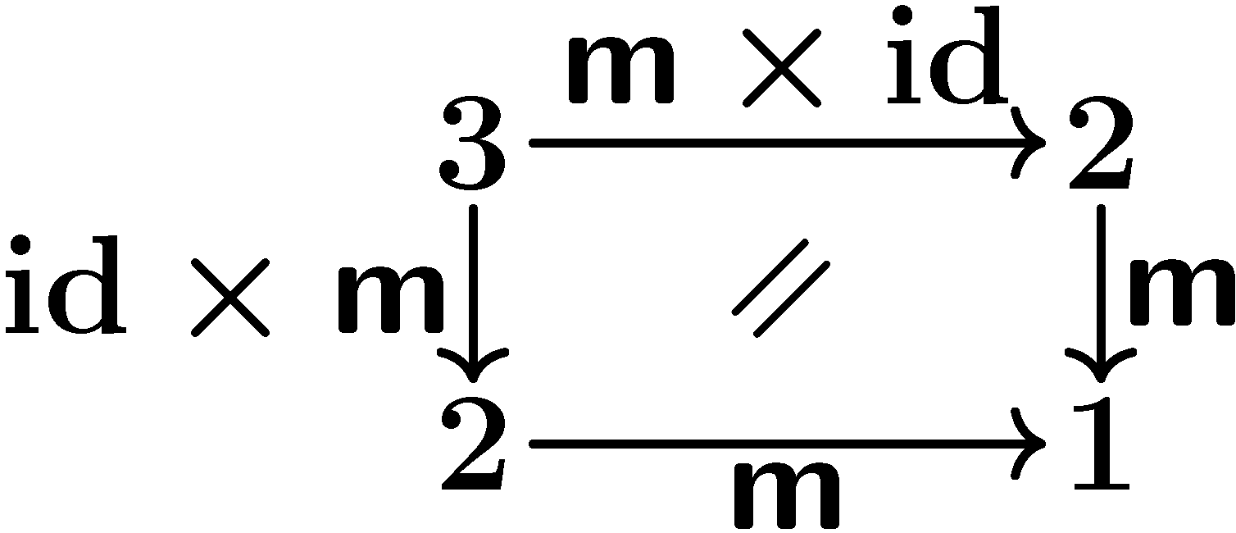
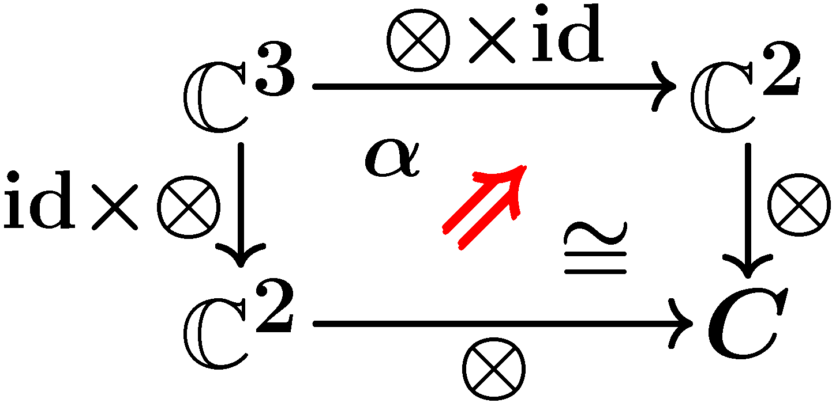
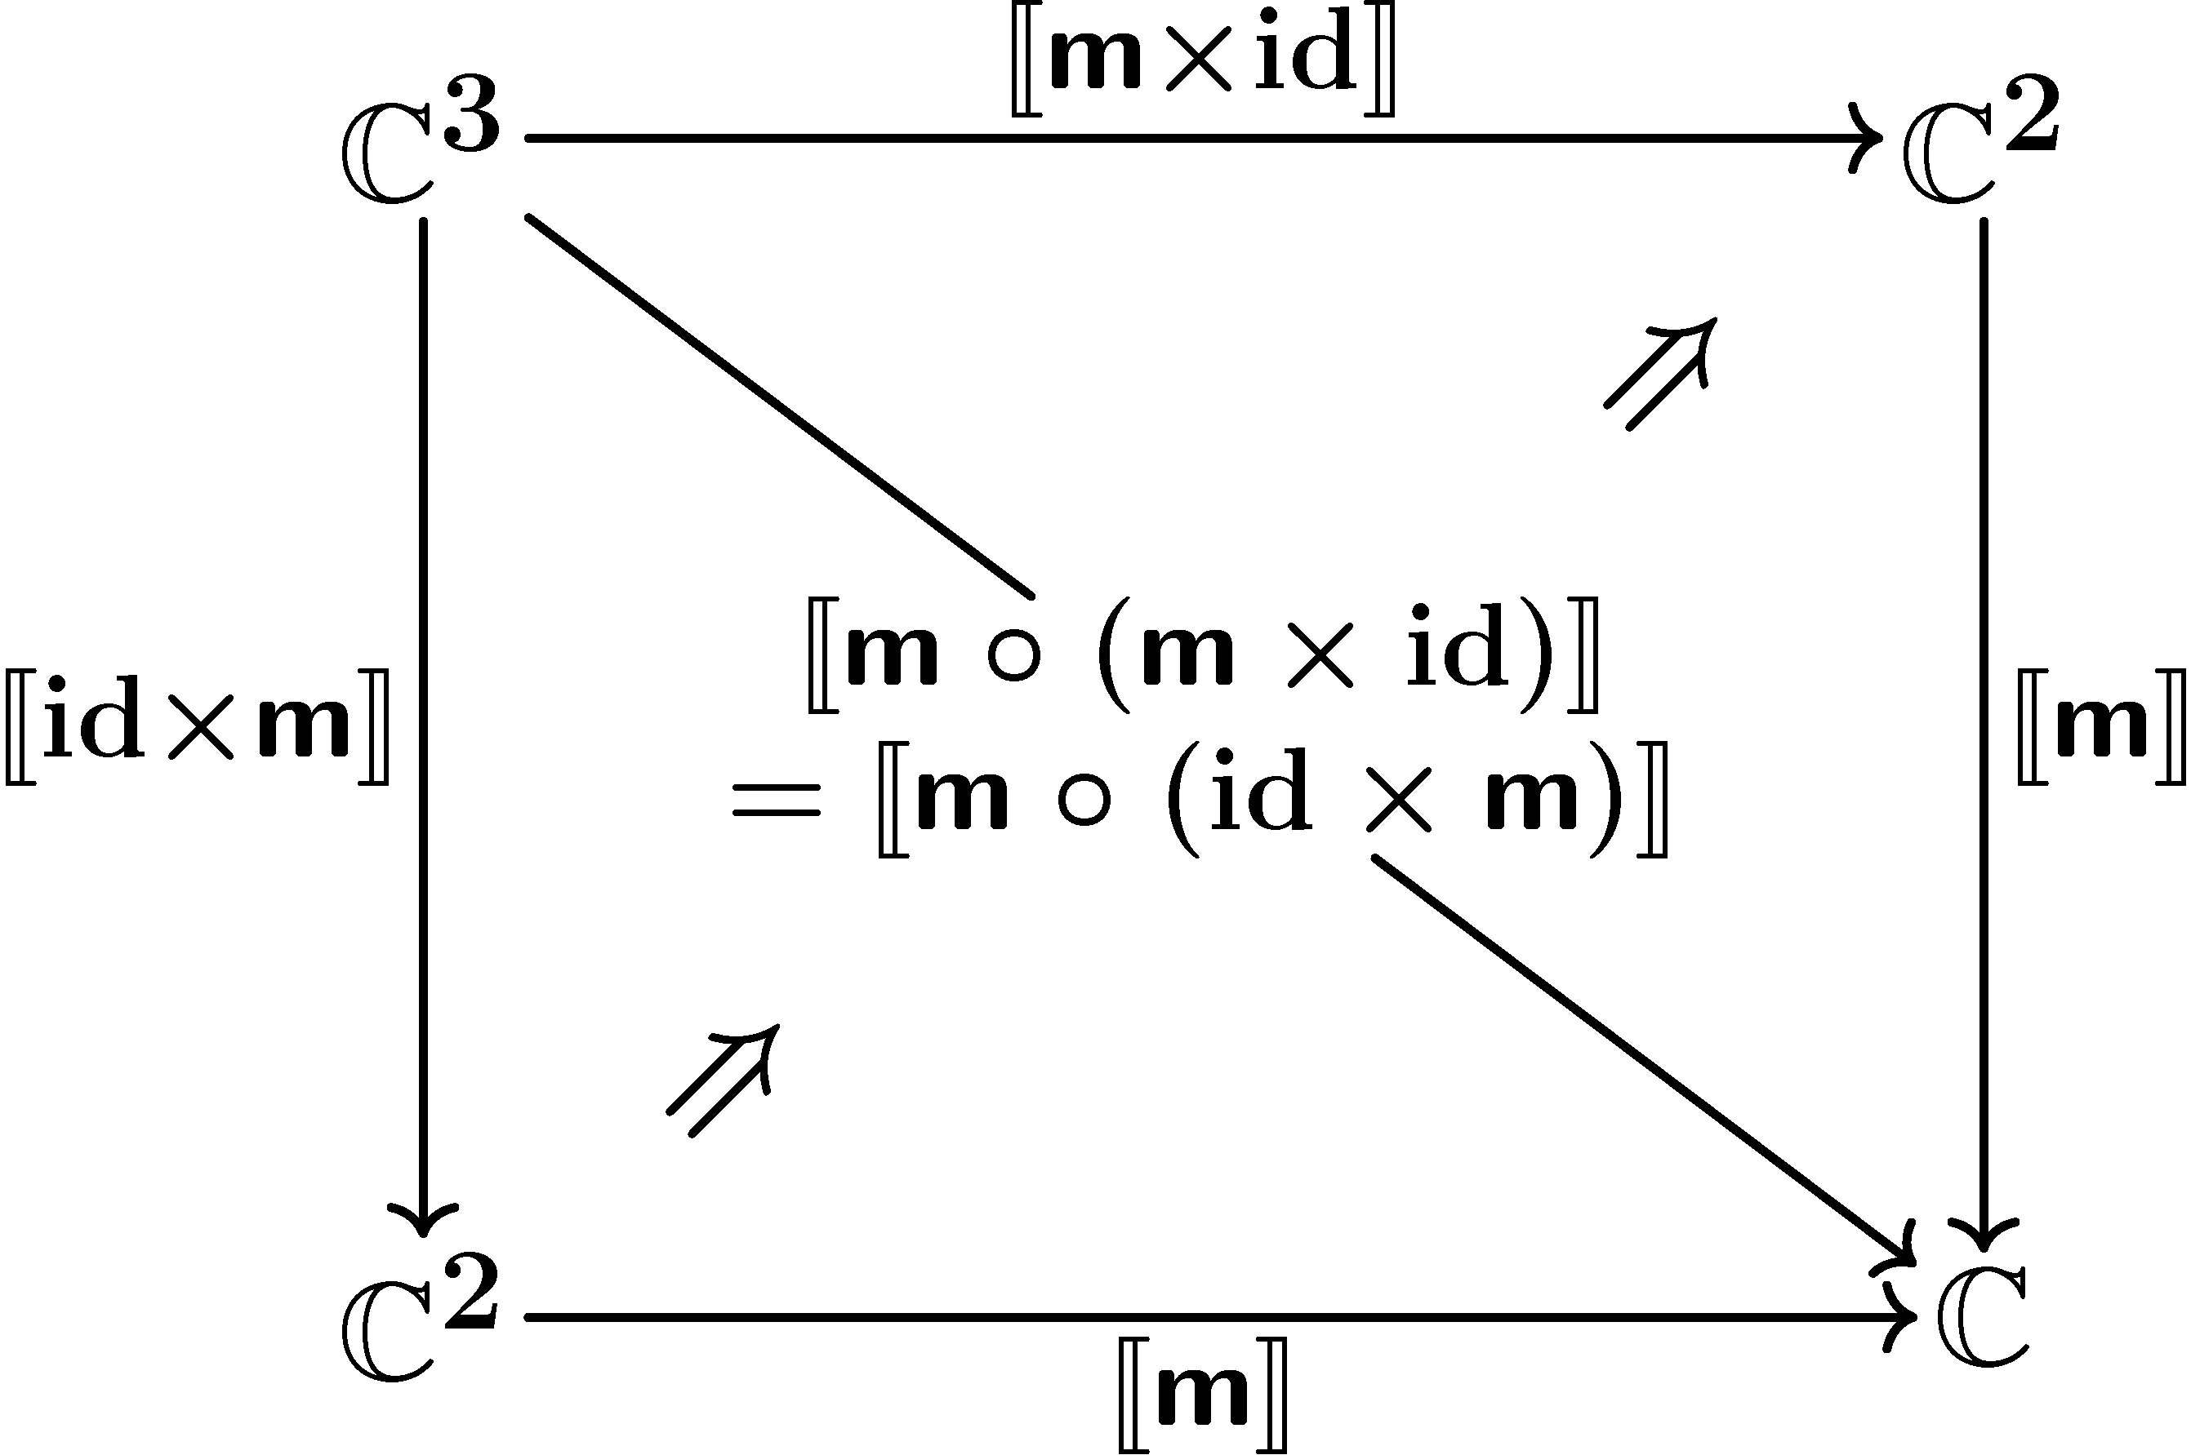
Pseudo functorial semantics
Definition
An L-category is a finite-product preserving pseudo functor L → CAT
pseudo functor preserves compositions/identities up-to iso:

Slide 32
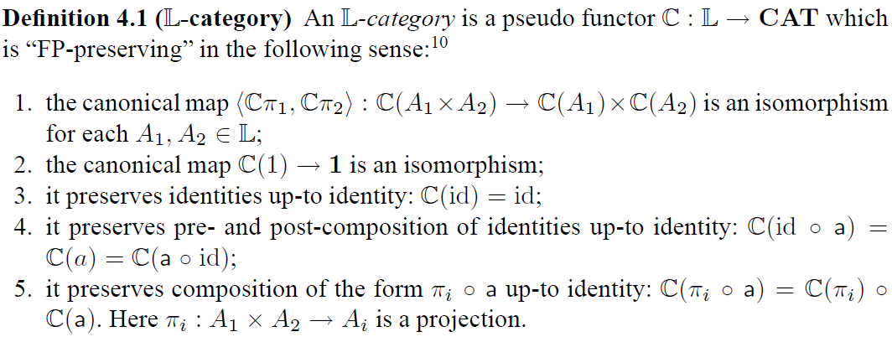
Pseudo functorial semantics
Definition
An L-category is a finite-product preserving pseudo functor L → CAT
natural, from an operadic point of view
subtle, needs fine-tuning
Theorem
[Leinster]

Slide 33
Compositionality theorem again
lifts
C is an L-category
F : C → C is a lax L-functor
there is a final coalgebra Z → FZ
Assume
1. Coalg_{F} is an L-category
2. Z → FZ is an L-object
3. the behavior functor
is a (strict) L-functor
by finality
yields
automatic
by coinduction
Notes:
kokokara!!

Slide 34
compositionality
results for
component calculi
Part 3

Slide 35
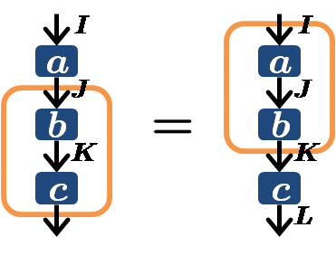
The calculi
I
I
f
J
g ± f
PLTh
g
K
(PipeLine)
K
sorts (I,J)
where I, J are sets
operations
seq. comp.
pure function
equations
stateless computation
I
f
J
I
I
a
a
J
J
b
b
K
K
c
c
L

Slide 36
The calculi
PLTh +
operation
sideline
equations
ArrTh
(Hughes’ arrow)
I
K
c
J
I
L
I
L
NB
cf. global state monad
a
a
=
J
I
L
I
L
I
K
I
K
J
b
a
=
a
a
≠
b
b
K
J
J
K
b
b
b
a
K
K
J
L
J
L

Slide 37
The calculi
PLTh
(PipeLine)
ArrTh
(Hughes’ arrow) = PLTh + first
MArrTh
(Monoidal arrow) = PLTh +
I
K
operation
(synchronous) parallel composition
equations
c
d
J
L

Slide 38
The calculi
PLTh
(PipeLine)
ArrTh
(Hughes’ arrow)
I
K
c
J
= PLTh + first
MArrTh
(Monoidal arrow) = PLTh +
I
K
= PLTh + k
d
c
J
L

Slide 39
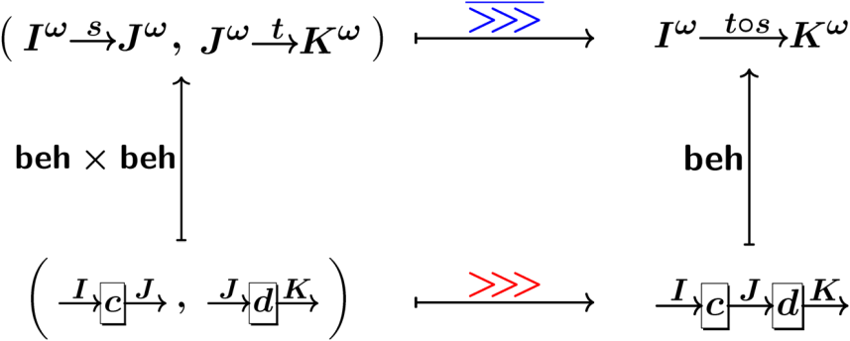
Our goal
For
“components as coalgebras”
constitute a microcosm model
for L,
in particular the compositionality theorem
I
c
as
J
i.e.

Slide 40
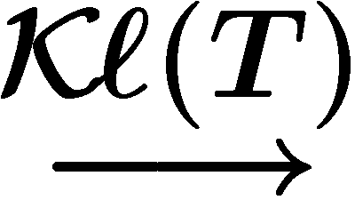
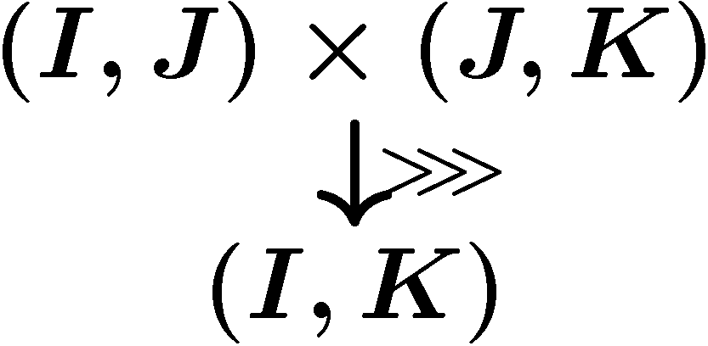
BTW, in functional programming…
Kleisli category Kl(T)
given a monad T for effect
the category of T -effectful computations:
The “hom-model”
Theorem [Power-Robinson]
arrow [Hughes]
Freyd category [Levy-Power-Thielecke]
Kl(T) is a (set-theoretic) model of PLTh
T: strong ➔ Kl(T) is a model of ArrTh
T: commutative ➔ Kl(T) is a model of MArrTh
“monoidal” arrow

Slide 41
Categorification
Follow from these outer models:
inner models
compositionality
I
c
as
J
signature:
Theorem [Power-Robinson]
Theorem
T: monad
➔ a model
T: strong monad
➔
T: commutative monad
➔
T: monad
➔ a model
T: strong monad
➔
T: commutative monad
➔

Slide 42
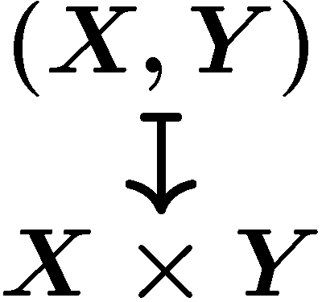
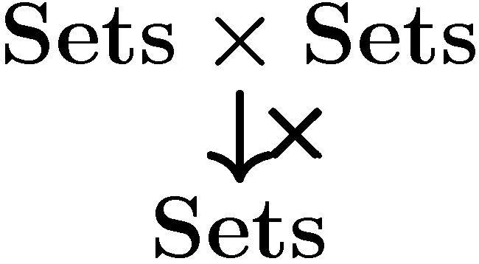
Proof of the theorem
exploiting the results on Kl(T)
Theorem
a model
lax compatible with PLTh
T: monad
a model
(hence an inner model, compositionality)
lifting
Lemma
, a model
“carrier set”

Slide 43
Proof of the theorem
exploiting the results on Kl(T)
Theorem
a model
lax compatible with PLTh
T: monad
a model
(hence an inner model, compositionality)
lifting
Lemma
, lax PLTh-functor
operations
equations
…
an morphism in PLTh, interpreted via
via equations in PLTh
Notes:
an arrow in L, interpreted via the model…

Slide 44
Future work
Richer component calculi
feedback → traced monoidal structure?
delayed/lossy channels → different effect monad T ?
Other “algebra in algebra”
for component calculi: L-algebra in L-algebra
in general: L₁-algebra in L₂-algebra
usually: L₂-algebra = “category with finite products”
Theory of generalized operads/combinatorial species
[Leinster] [Fiore-Gambino-Hyland-Winskel] [Curien]

Slide 45
Conclusions
The Microcosm Principle
what’s new: many-sorted, pseudo algebra
components (state-based machines) | as | coalgebras
their behaviors | by | final coalgebra
calculus on them | as | algebraic structure
Hughes’ arrow, Freyd category, … from functional programming
compositionality
results
Thanks for your attention!
Ichiro Hasuo (Kyoto, Japan)
http://www.kurims.kyoto-u.ac.jp/~ichiro

Slide 46
Conclusion

Slide 47
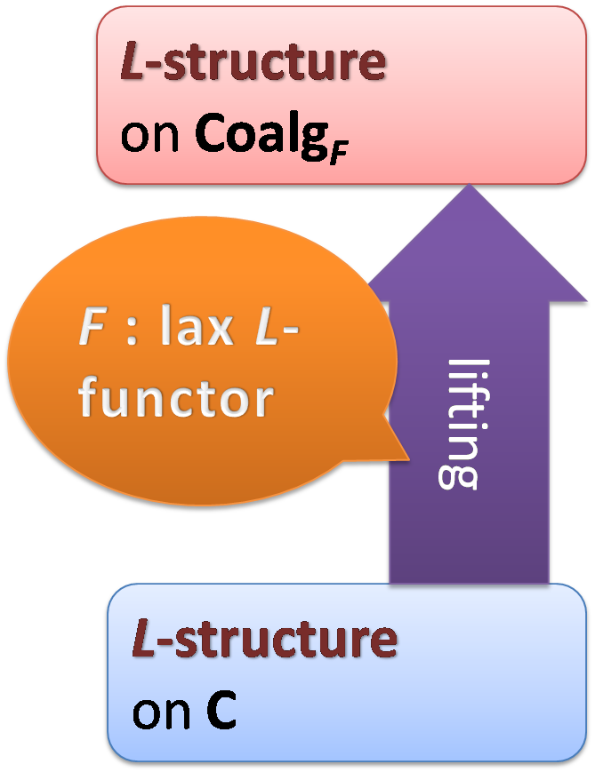
Compositionality theorem
C is an L-category
F : C → C is a lax L-functor
there is a final coalgebra Z → FZ
Assume
1. Coalg_{F} is an L-category
obtaining

